Slide 1

Spot the typos
Do this now
15 seconds per slide
Note the error in your exercise books

Slide 2
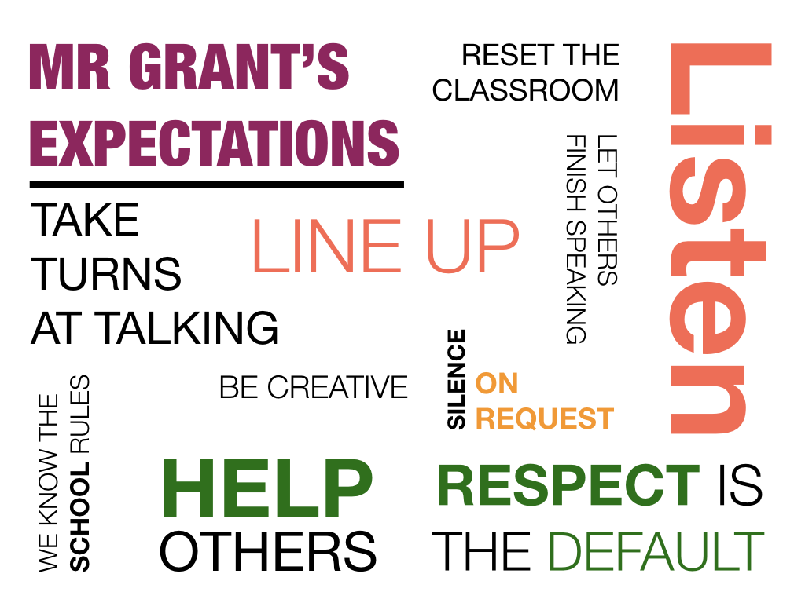
Expectations
HOMEWORK WILL PREPARE FOR CLASS

Slide 3
TITLE SUBTITLE
Lesson 1
Short Detail

Slide 4
All students will know
Learning Objectives
How to declare and use constants and variables
The main data types: integer, real, Boolean, character and string
Notes:
Define IDE

Slide 5
All students will understand
Learning Objectives
Understand and use data types: integer, real, Boolean, character and string
How Python handles different data types.
What a syntax error is and how to embrace error messages

Slide 6
Some students will understand
Learning Objectives
casting variables between data types
Variable scope: local and global scope

Slide 7
All students will be able to
Learning Objectives
Convert from pseudocode and flowcharts to Python programs
Use input, output and assignment statements
Use arithmetic operators including MOD (% in Python) and DIV (// in Python)
Use string concatenation, formatting and conversion functions

Slide 8
You have experience of
Learning Objectives
Using IDLE in script mode
Saving and Organising .py files
Assigning and re-assigning variables
Pseudocode and Flowcharts
Some Python…

Slide 9
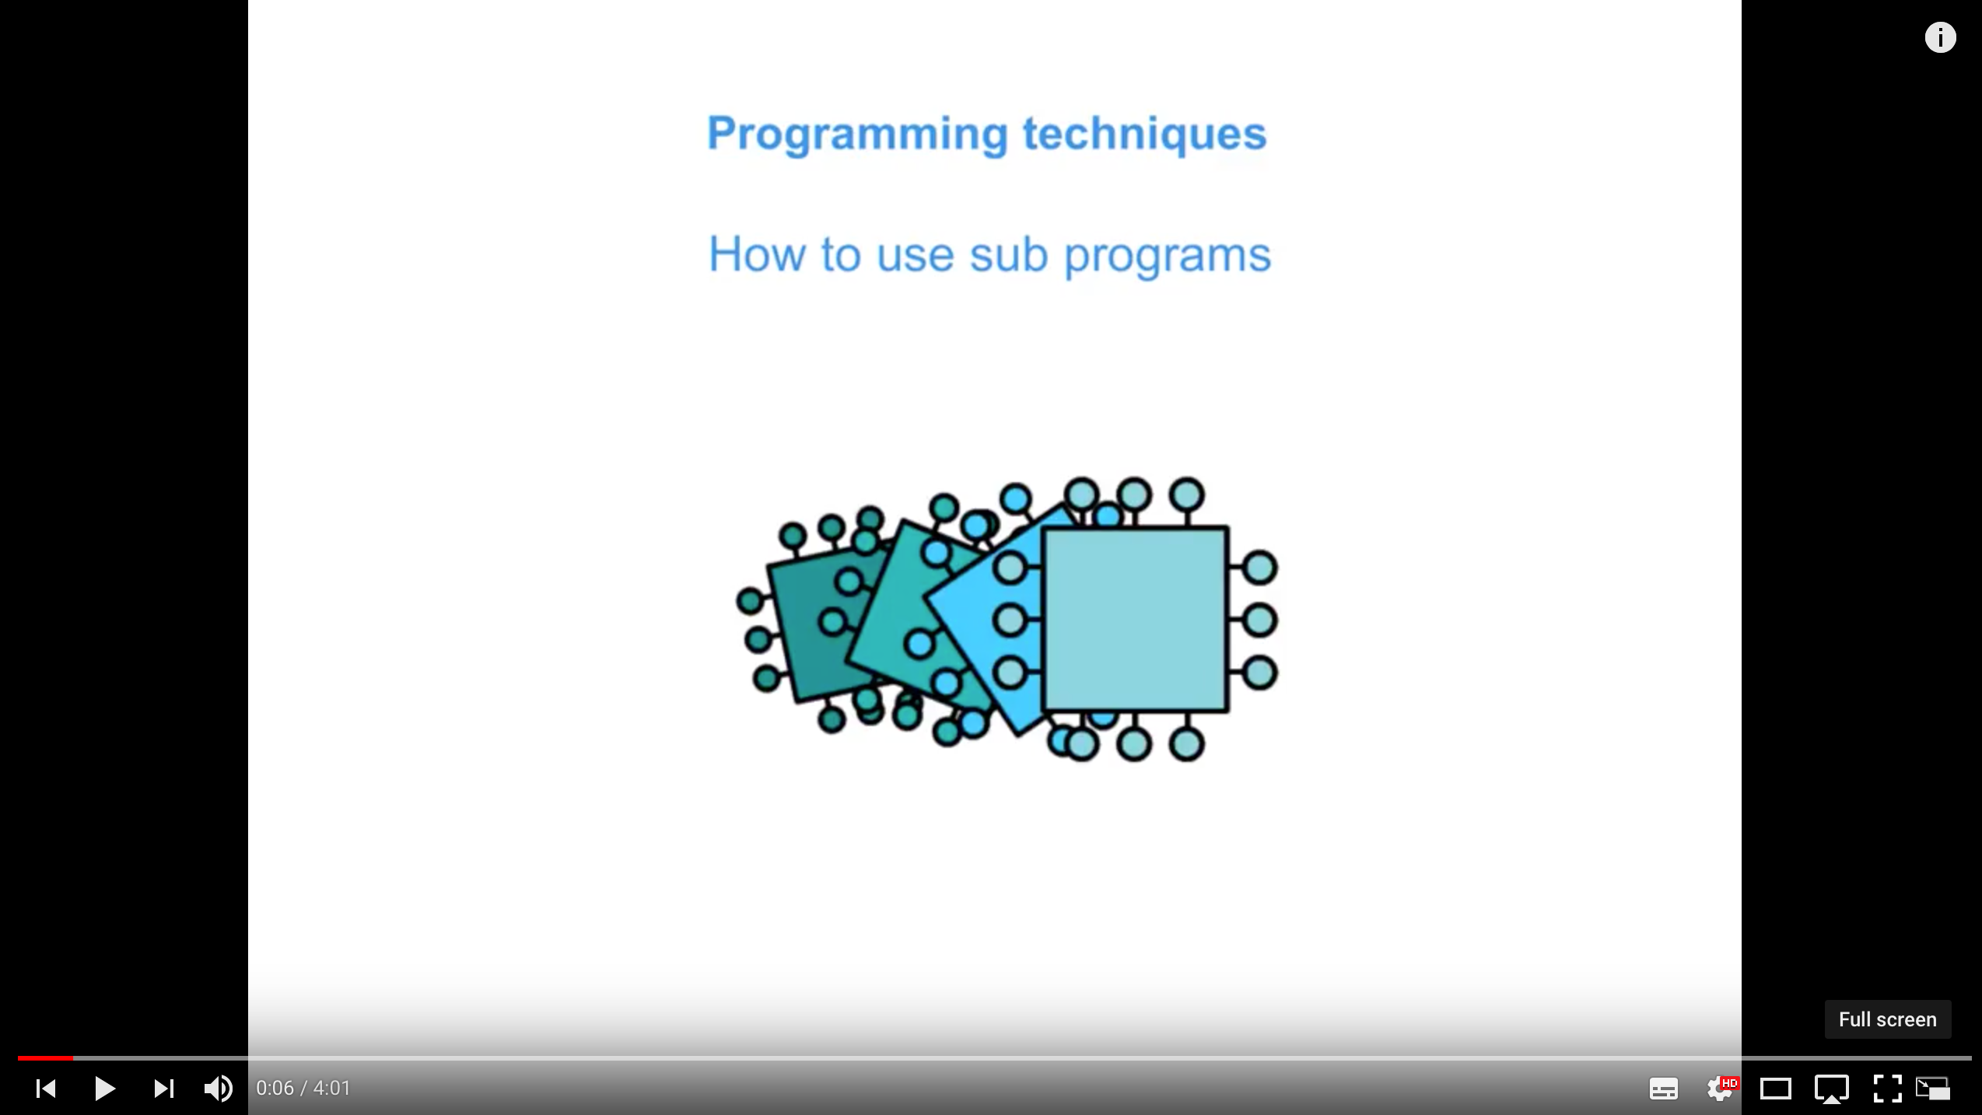
Watch and take notes
How to use sub programs
Notes:
https://www.youtube.com/watch?v=9gyO0ZOXQU4&list=PLCiOXwirraUDRk5TlB2ulS3V2-0tB3vcS&index=6

Slide 10
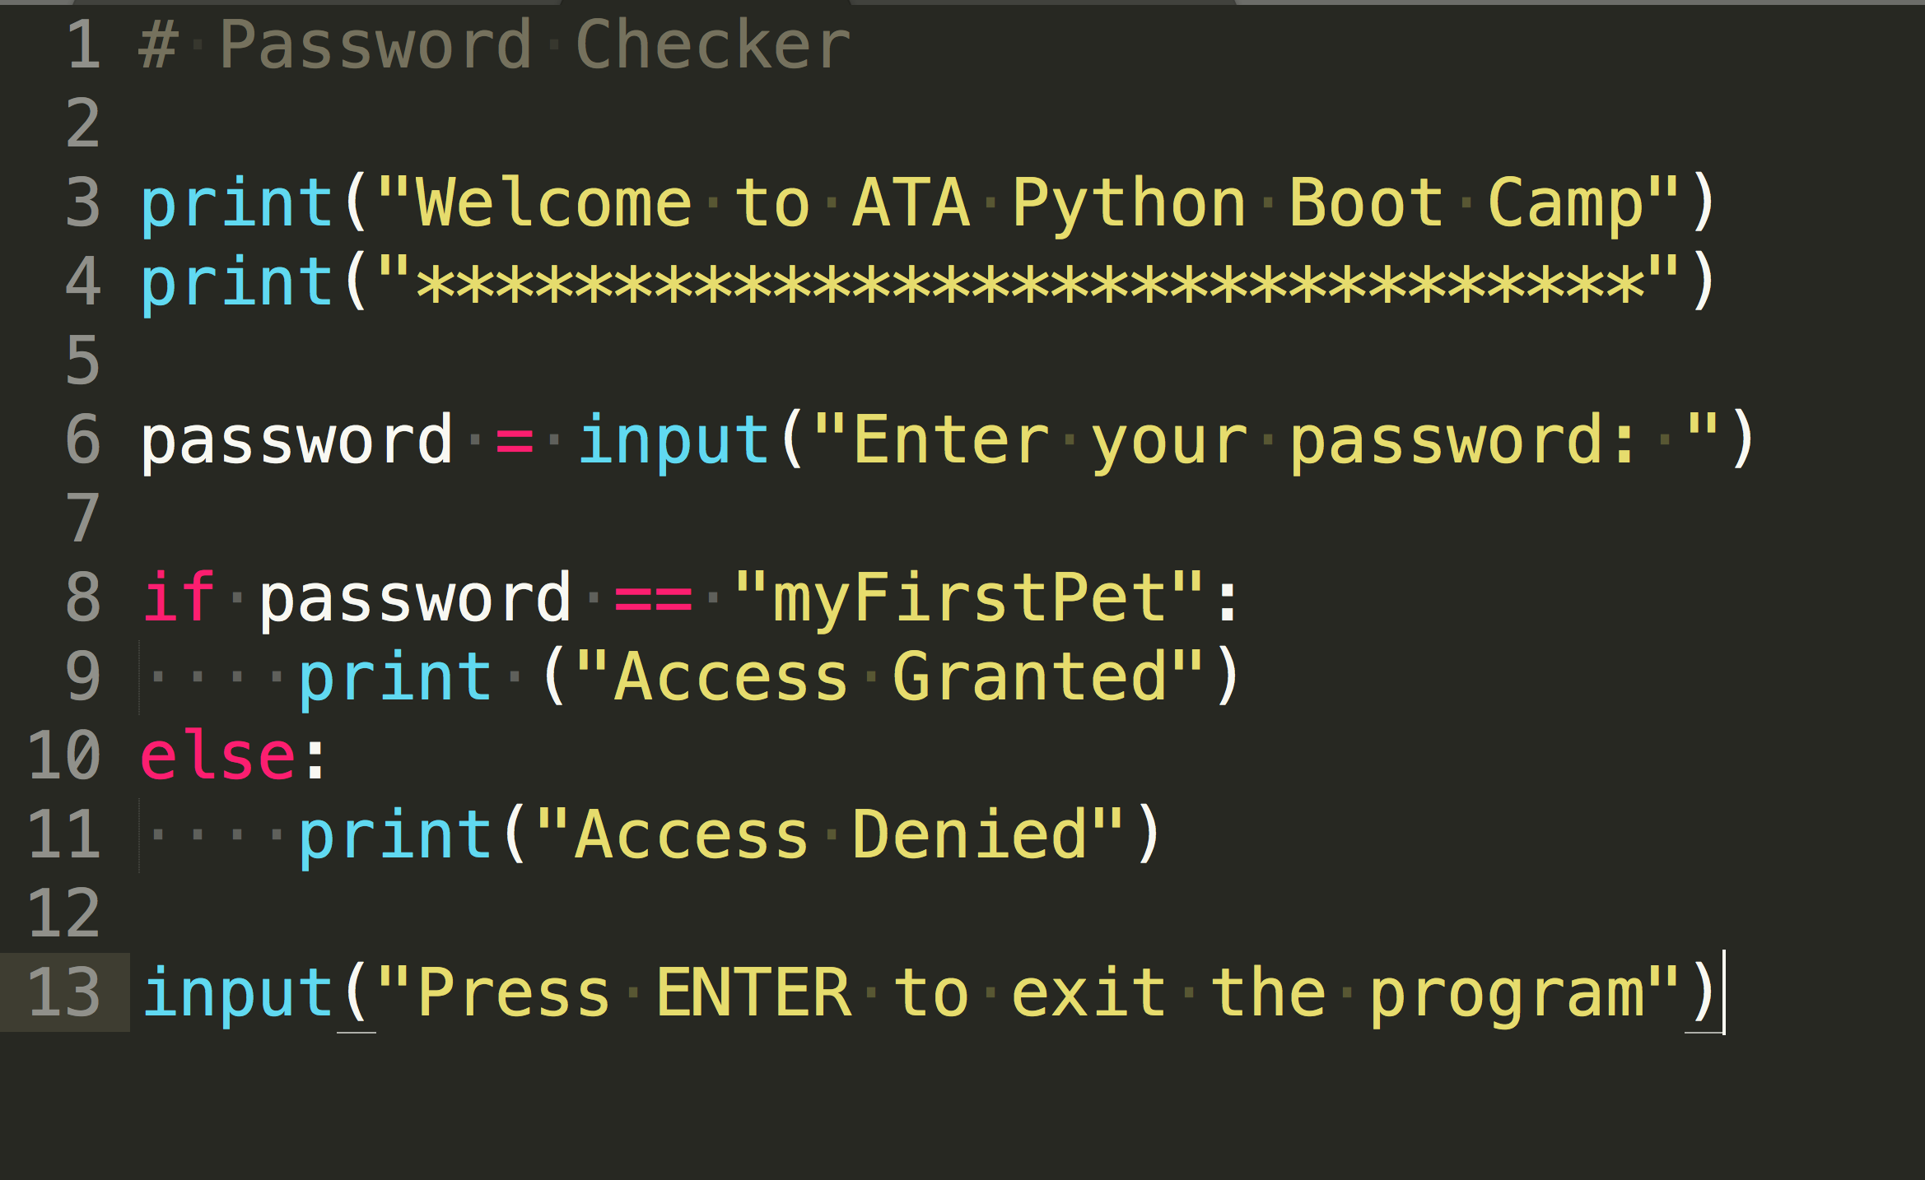
Example Code
Notes:
Can anyone tell me what this code does?

Slide 11
Example Code
Headline Text
What types of variables are shown here:
numberOfStudents = numberOfStudents + 1
circleArea = 3.142 * radius * radius
while found == False …
answer = “Y”
print (studentName)
integer
Real or float
Boolean
char
string

Slide 12
Definitions of data types
Table
Data type | Type of data | Typical amount of Memory
integer
A whole number: 1, 0, -2
2 bytes
Real or float
A number with a decimal point: 1.5, 0.0, -68.4
4 bytes
A single ASCII character: A, b, 3, ! Or [space]
1 byte
char
Boolean
True or False; 1 or zero
1 bit; but commonly 1 byte
string
Zero or more characters
1 byte per character in string
Notes:
Guess

Slide 13
Summary
Python’s Development Environment
As well as variable, you can define constants in a program
PI = 3.14157926535
MONTHLYTARIFF = 15.60
Constants are typically shown in uppercase
Why declare a constant instead of a variable?
Can a constant ever change its value?
Notes:
Quickly demonstrate INTERACTIVE and SCRIPT mode.

Slide 14

Tasks
Independent Activities
Continue with Worksheet 3 -
Complete Task 1, 2 and 3
Complete what's left task 4 and Task 5 for homework
Location: On StudentShare:
Notes:
Highlight

Slide 15
Plenary
Plenary
We have seen how to:
use data types: integer, real, Boolean, character and strings
declare and use constants and variables
use input, output and assignment statements
use arithmetic operators including MOD and DIV
use string methods and conversion functions
Notes:
How was that? Any questions? How do you feel?

Slide 16
Homework
Worksheet 3
Complete the tasks (1-5) and extensions for extra credit in the lesson worksheet and upload to ShowMyHomework.
Use the Powerpoint slides (48-64) for info.
Location: On StudentShare:
//ICT / Mr Grant / Year 10/ GCSE Computer Science / 10Y (Mr Phillips) / Y10y Python Worksheet 3 Data Types and Strings.docx /
Notes:
How was that? Any questions? How do you feel?

